Slide 1

Slide 1
Consumer Complaints

Slide 2




Slide 2
Problem Statement
One of the primary issue for a company is understanding and improving customer satisfaction with regard to the handling of consumer complaints.
There is a need to identify factors contributing to dissatisfaction, delays in resolution, and the channels through which complaints are most effectively managed.
This analysis aims to uncover these insights to enhance customer service and operational efficiency.

Slide 3

Slide 3
Objective
The objective of this project is to analyze consumer complaint data to identify trends and patterns that can inform strategies for improving customer satisfaction, reducing resolution times, ensuring timely responses, and minimizing disputes.
This involves examining the performance of different companies, products, and complaint channels to pinpoint areas for improvement and best practices.
Your logo

Slide 4

Dataset Overview
Data source: Internet
Time period: 2013-2016
Data size: datatset_consumer_complaints (14000)
Key Columns: Company, Resolution time, Issue, Submitted via, product

Slide 5
MY DASHBOARD

Slide 6
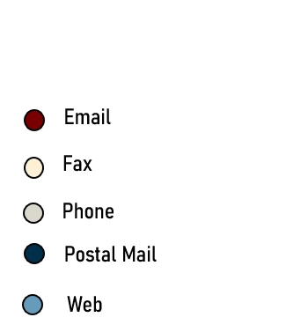
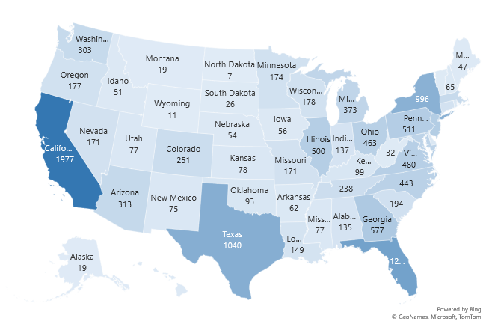
Sources of Complaint
Email is the most common channel for submitting complaints
Other channels like phone, postal mail, and web are also used to some extent.
Fax is still used for a small percentage of complaints.
California has the highest number of complaints (1977), followed by Texas (1040) and Florida (1255).
Alaska has the lowest number of complaints (19).

Slide 7
Yearly Complaints and Resolving Time
The number of complaints has generally decreased from 2013 to 2016
The average resolving time has also decreased over the same period
Companies with most timely response
Bank of America has the highest number of complaints, followed by Wells Fargo & Company and JPMorgan Chase & Co.
Equifax has the lowest number of complaints.

Slide 8
Slide 5
Average Issue Per Product
Mortgage has the highest number of complaints (3346), followed by Account or Services (2429) and Credit card (2752).
Virtual currency has the lowest number of complaints (1).
Top 10 Companies with Issues and avg Resolving time
Bank of America has the highest number of complaints (1066), followed by Wells Fargo & Company (947) and JPMorgan Chase & Co. (877).
U.S. Bancorp has the lowest number of complaints (309).
The average resolving time varies among companies, with Equifax and Ocwen having the lowest average resolving times (0.8).

Slide 9
Primary Insight
Customer Satisfaction Rate
Average Resolution Time
Timely Response Rate
77.59%
2.01
98.39%
Avg Issue Per Product
Total Issues
Total Companies
1166.6
14000
3471

Slide 10

Conclusion
Customer Satisfaction: Increase the overall customer satisfaction rate by addressing specific pain points and improving customer experience.
Issue Per Product: Reduce the average issue per product by identifying and addressing product-specific issues.
Complaint Volume: Implement strategies to reduce the overall volume of complaints, such as improving product quality, enhancing customer education, and optimizing complaint handling processes.
Resolution Time: Continue to optimize complaint resolution processes to further reduce the average resolution time.
Company Performance: Provide additional support and resources to companies with high complaint volumes or long resolving times to help them improve their performance.
Communication Channels: Evaluate the effectiveness of different communication channels and optimize them to enhance customer communication and satisfaction.

Slide 11
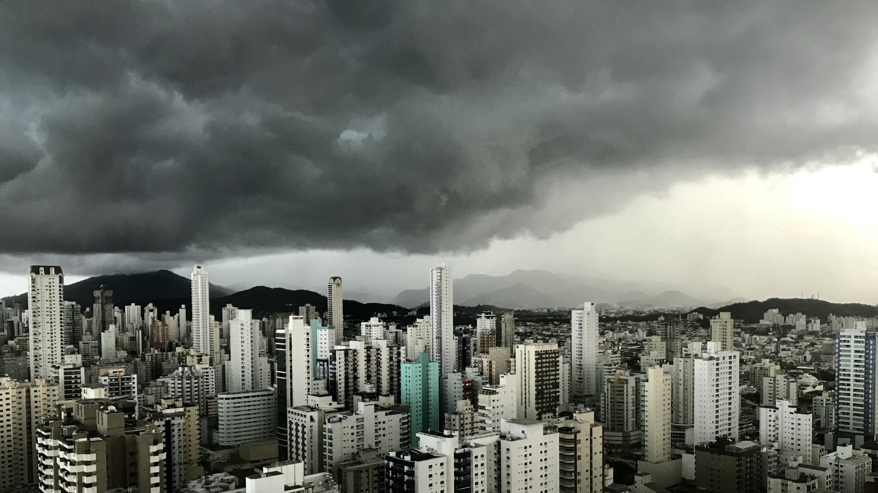
Slide 11
THANK YOU

